Slide 1

JEE Main & Advanced
Chapter-wise Weightage Analysis
Comprehensive Analysis for Strategic Preparation
June 2025

Slide 2




Introduction
Understanding JEE Exams
JEE Main:
First-level entrance exam for admission to NITs, IIITs, and other CFTIs
Understanding
helps in strategic preparation
chapter-wise weightage
JEE Advanced:
Second-level exam for admission to IITs, only for top JEE Main performers
Allows students to
based on their importance in the exam
prioritize topics
Both exams test
Physics, Chemistry, and Mathematics
Helps in
efficient time management
during preparation
with different difficulty levels
This analysis is based on previous years' question papers and official exam patterns to provide the most accurate weightage distribution.

Slide 3
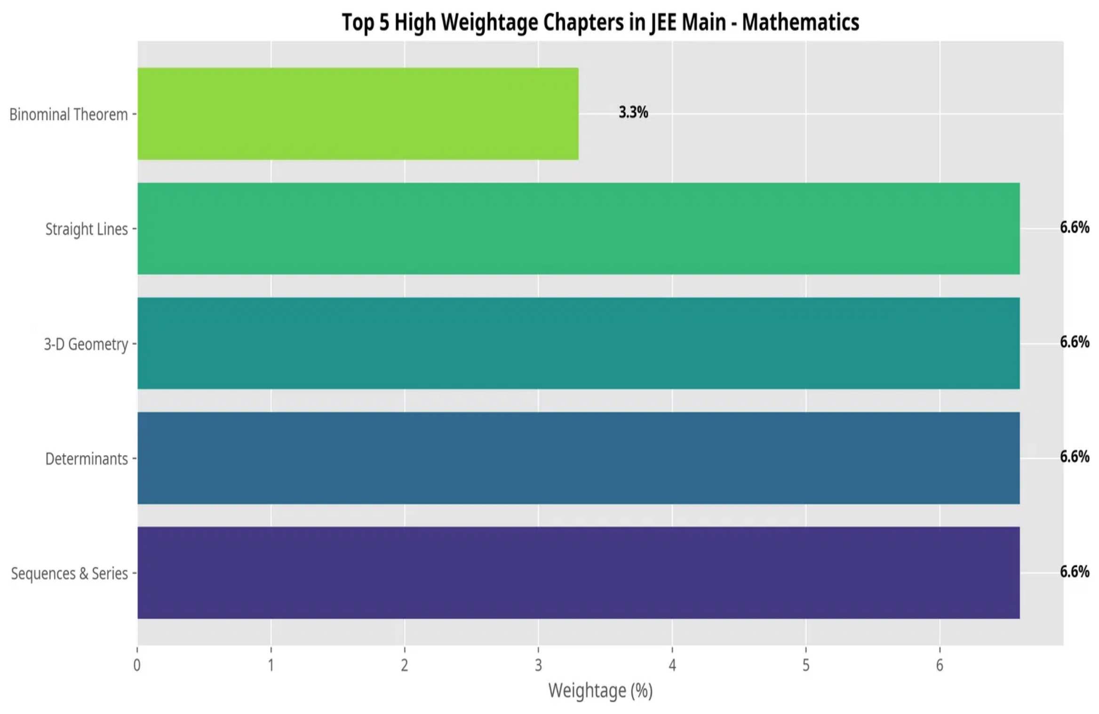

JEE Main: Mathematics Weightage
Top Chapters by Weightage
Key Insights
Four chapters
with 6.6% weightage each: Sequences & Series, Determinants, 3-D Geometry, and Straight Lines
Most chapters have
of 3.3% (1 question each)
equal weightage
Calculus
topics collectively form a significant portion (~15%)
Coordinate Geometry
(Straight Lines, Conics) accounts for ~13% of questions
Focus on chapters with 6.6% weightage while maintaining balanced preparation across all topics.

Slide 4
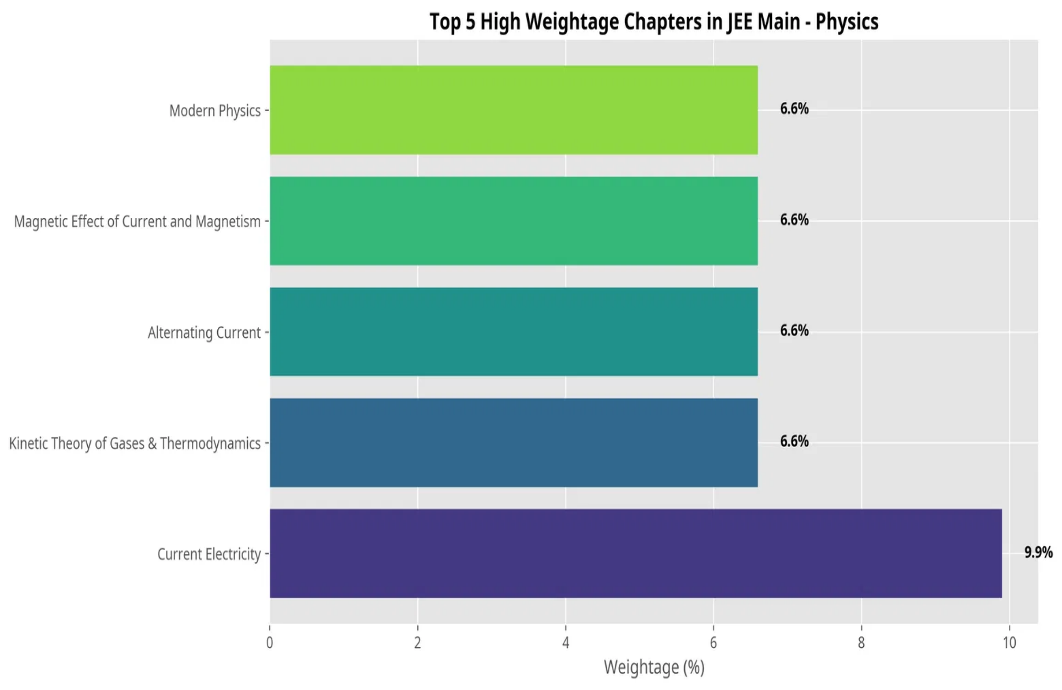


JEE Main: Physics Weightage
Top Chapters by Weightage
Key Insights
Current Electricity
has the highest weightage (9.9%) in Physics
Electromagnetism topics
collectively account for ~20% of the paper
Modern Physics
are significant with 6.6% each
and
Thermodynamics
Mechanics topics
(Laws of Motion, Work-Energy, Rotational Dynamics) together form ~20% of questions
Electricity and Mechanics form the backbone of JEE Main Physics, requiring thorough preparation.

Slide 5
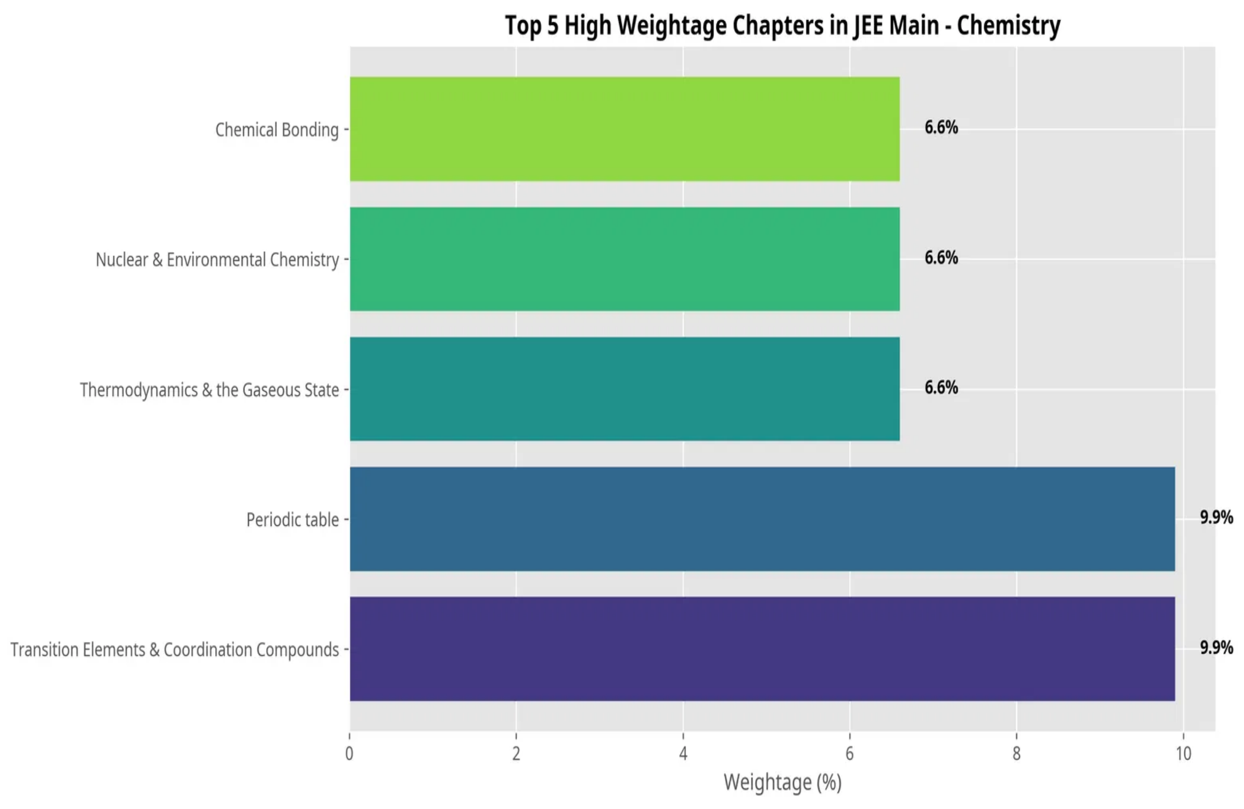

JEE Main: Chemistry Weightage
Top Chapters by Weightage
Key Insights
Transition Elements & Coordination Compounds
and
Periodic Table
have highest weightage (9.9% each)
Inorganic Chemistry
topics collectively form ~30% of the paper
Physical Chemistry
topics (Thermodynamics, Chemical Equilibrium) account for ~25% of questions
Organic Chemistry
has more evenly distributed weightage across multiple chapters
Inorganic Chemistry topics have higher individual weightage, making them crucial for scoring well.

Slide 6
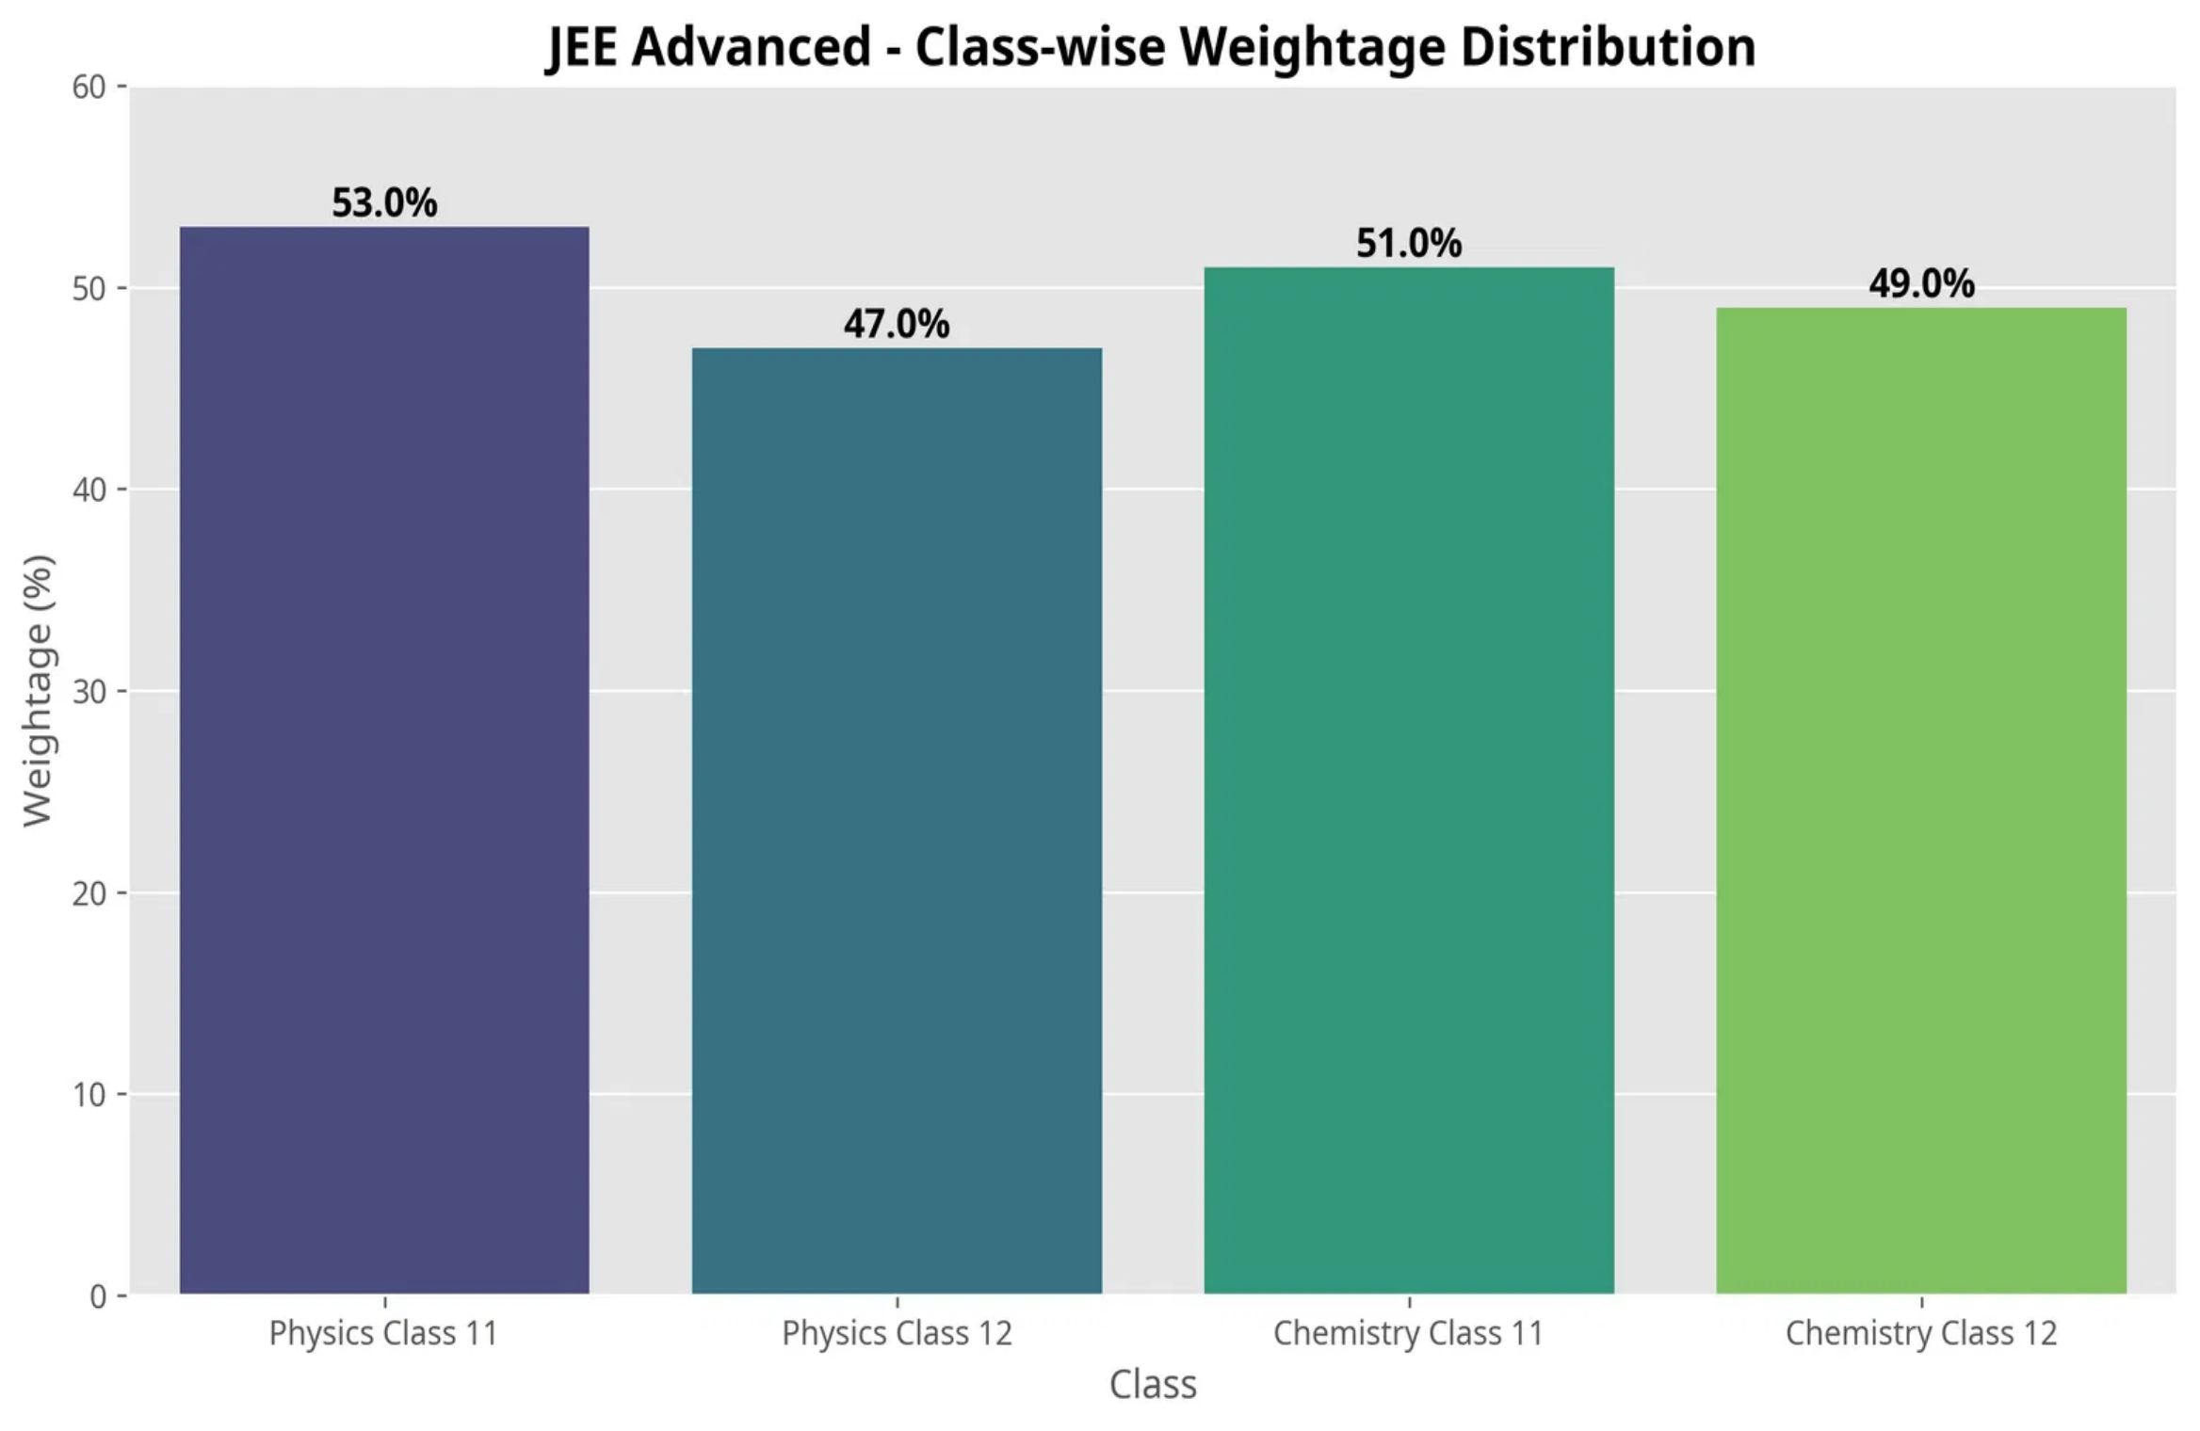

JEE Advanced: Class-wise Distribution
Class-wise Weightage Distribution
Key Insights
Class 11 topics
have slightly higher weightage in both Physics (53%) and Chemistry (51%)
The distribution is nearly
between Class 11 and Class 12 syllabus
balanced
Unlike JEE Main, Advanced has a more
structured weightage distribution
with clear focus areas
JEE Advanced questions are more
conceptual and application-based
compared to JEE Main
Equal importance should be given to both Class 11 and Class 12 topics for JEE Advanced preparation.

Slide 7
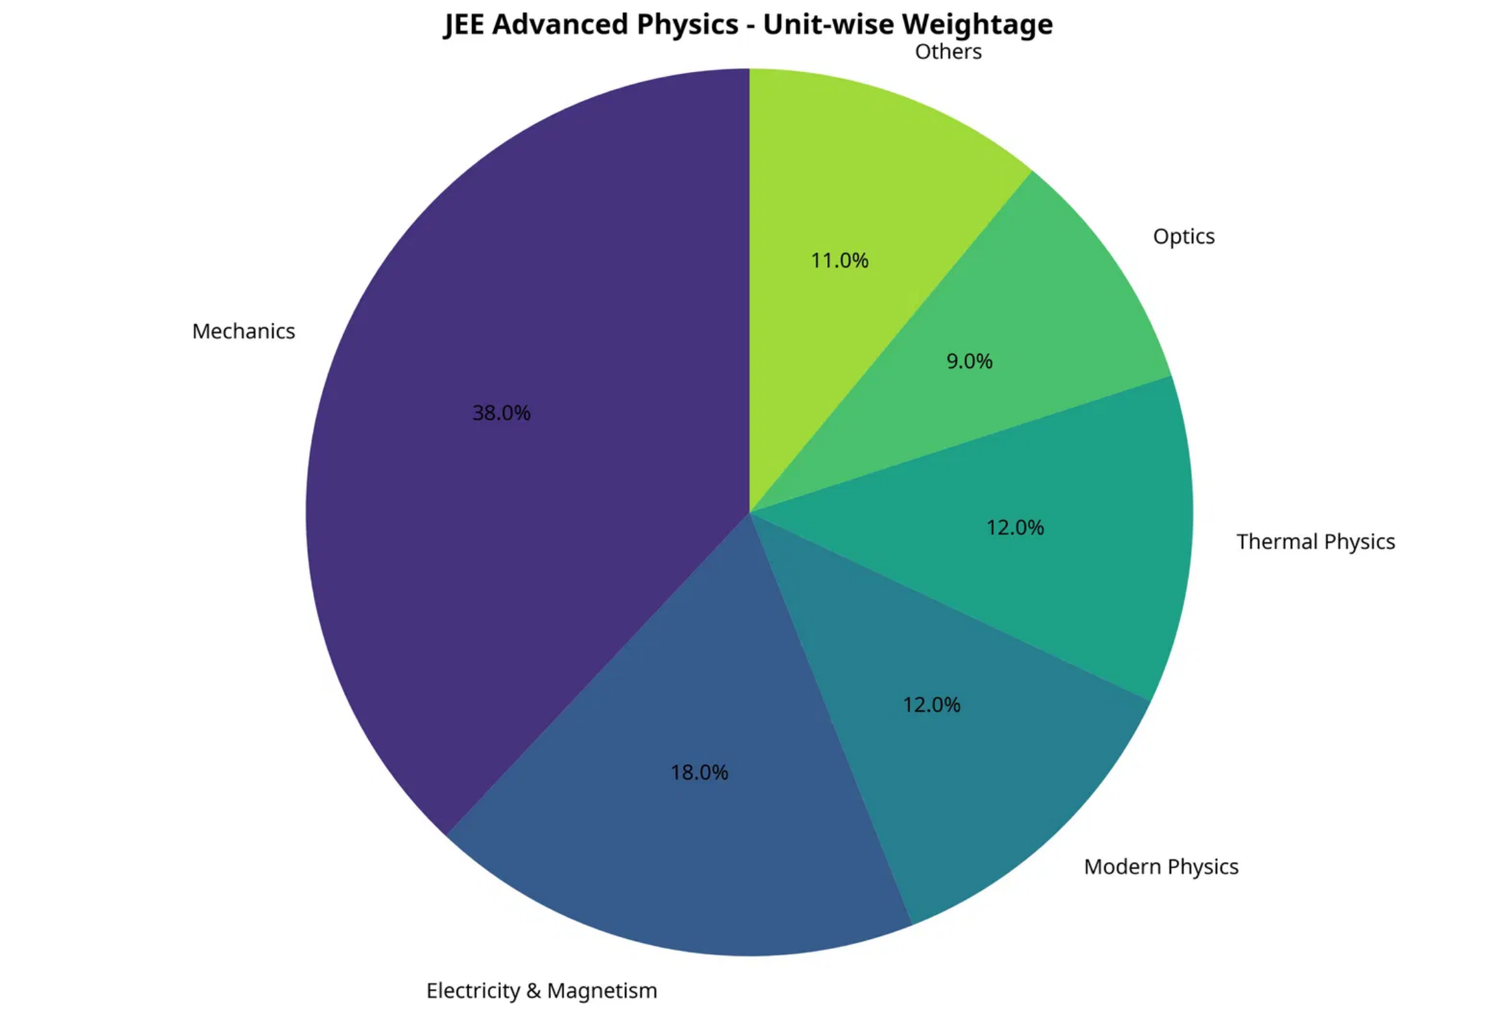

JEE Advanced: Physics Weightage
Unit-wise Weightage Distribution
Key Insights
Mechanics
dominates with 38% weightage - the single largest unit in JEE Advanced Physics
Electricity & Magnetism
is the second most important unit (18%)
Modern Physics
have equal weightage (12% each)
and
Thermal Physics
Important topics within Mechanics include
Centre of mass
Fluid Mechanics
(7%),
Rigid Body Dynamics
(5%), and
(5%)
Mechanics and Electricity & Magnetism together account for 56% of the JEE Advanced Physics paper.

Slide 8

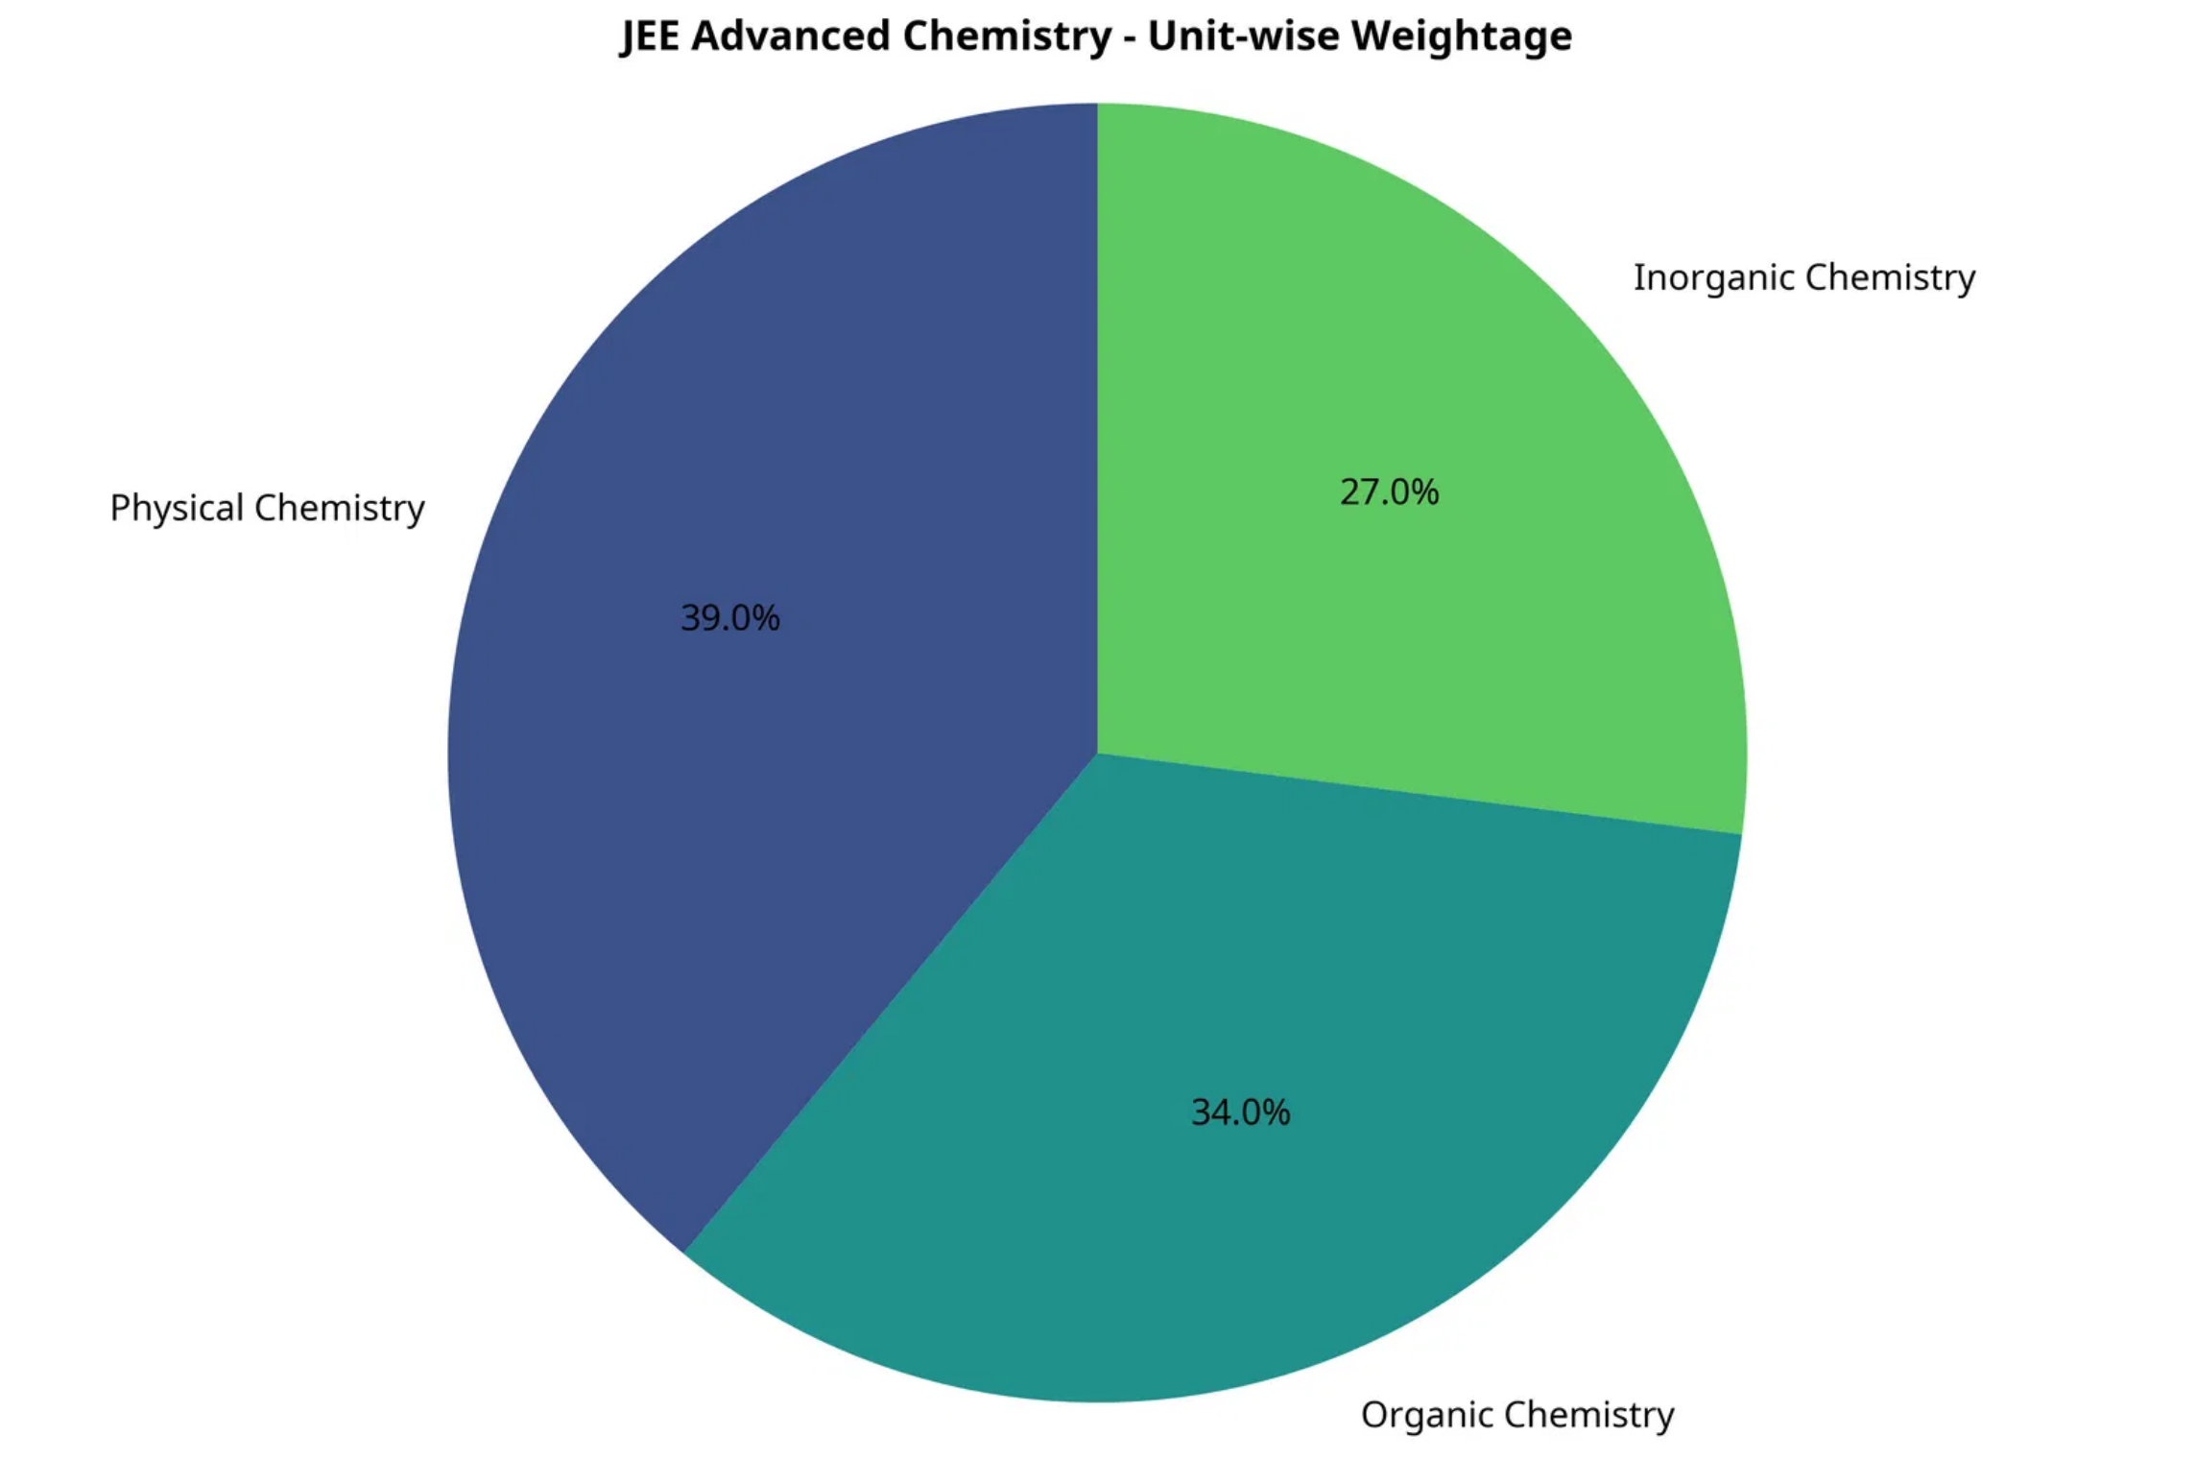
JEE Advanced: Chemistry Weightage
Unit-wise Weightage Distribution
Key Insights
Physical Chemistry
has the highest weightage (39%) in JEE Advanced Chemistry
Organic Chemistry
follows closely with 34% weightage
Important topics in Physical Chemistry include
Chemical Thermodynamics
(8%) and
Chemical Equilibrium
(6%)
In Organic Chemistry,
(8%) carry significant weightage
Benzene
(8%) and
Phenols
In Inorganic Chemistry,
(10%) is the most important topic
Chemical Bonding
Physical and Organic Chemistry together account for 73% of the JEE Advanced Chemistry paper.

Slide 9
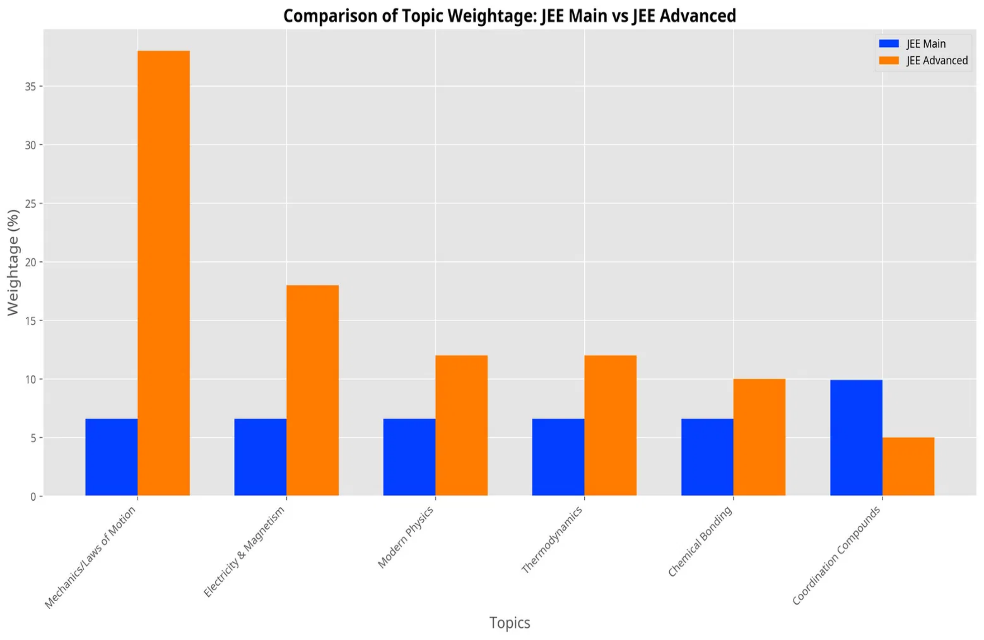

JEE Main vs Advanced: Comparison
Topic Weightage Comparison
Key Differences
JEE Advanced
has more concentrated weightage in fewer topics (e.g., Mechanics 38% vs 6.6% in Main)
JEE Main
has more uniform distribution of marks across chapters
In Chemistry,
emphasizes Physical Chemistry (39%) more than
JEE Advanced
JEE Main
(~25%)
Coordination Compounds have higher weightage in
JEE Main
(9.9%) compared to
JEE Advanced
(5%)
JEE Advanced requires deeper understanding of core concepts, while JEE Main tests broader knowledge across the syllabus.

Slide 10





Preparation Strategy
Strategic Approach Based on Weightage Analysis
For JEE Main
For JEE Advanced
Focus on
Transition Elements
Current Electricity
,
Master
Mechanics
(38%) and
Physical Chemistry
, and
Sequences & Series
(39%) as top priorities
Ensure balanced preparation across all chapters as weightage is more evenly distributed
Develop deep conceptual understanding rather than surface-level knowledge
Practice more numerical problems from
Give equal importance to Class 11 and Class 12 topics
Electromagnetism
and
Mechanics
topics
General Preparation Tips
Start with
to build confidence
high weightage chapters
Practice
to understand exam patterns
previous year questions
Create
topic-wise revision notes
for quick review
Take
regular mock tests
to improve time management
Remember: Understanding concepts thoroughly is more important than just covering the syllabus!

